Slide 1
Pointers and References

Slide 2
In C
b
10
char b = 10 ;
0xAAB
char * p ;
p
0xFCB
p = &b ;
print p
print (*p); <= this is called dereferenc

Slide 3
Dereference in C
class X {
int value ;
char b ;
}
struct X {
int value ;
char b ;
}
X m ;
X* p ;
p = &m ;
(*p).value ;
p->value ;

Slide 4
How pointer and dereferencing are implemented?
.data
bVal BYTE 10
mov esi, bVal ; ESI = 10
mov esi, OFFSET bVal ; ESI = 00404000h address of bVal
mov esi, [esi] ; ESI = 10 ; load from bVal

Slide 5
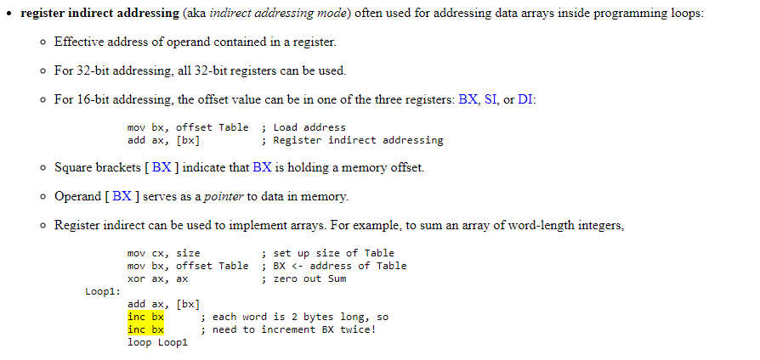

Slide 6
How to swap two variables in C? (pass by address)
Main() {
char x = 10, y= 5 ;
}

Slide 7
C++ ‘s pass by reference

Slide 8
Java ‘s pass by reference?

